Slide 1
How to best use these slides…
View the PPT as a slide show
Then click through every step
Mouse clicks will advance the slide show
Left/right arrow keys move forward/backward
Mouse wheel scrolling moves forward/backward
When a question is posed, stop and think it through, try to answer it yourself before clicking
If you have questions, email me, ask in the Teams Student Center channel!

Slide 2
LESSON 1.3c
Modeling: Finding 1) Lines of fit and 2) Lines of BEST fit

Slide 3
Today you will:
Learn strategies and techniques for finding equations of data that doesn’t exactly fit on a line.
Learn what a “Line of fit” is and how to find it. This is a “by hand” method.
Learn what a “Line of BEST fit” is and how to find it. This is a “calculator” method.
Practice using English to describe math processes and equations.

Slide 4
Core Vocabulary:
Line of fit, p. 24
Line of best fit, p. 25
Correlation coefficient, p. 25
Prior:
Slope
Slope intercept form
Point-slope form
Scatter plot

Slide 5

Review/Recap
Slope:
steepness and tilt of a line
Change in y divided by change in x between any two points on the line
When evaluating visually, move left-to-right along the line on the graph
$m=$
Most common equation forms for lines (Iinear equations)
Slope-intercept:
Point-slope:
Story/word/real-world problems
Read it and decompose the text into
Background info
What I am given
What I need to do/find
$$\frac{y_{2}−y_{1}}{x_{2}−x_{1}}$$
$$y=mx+b$$
$$y−y_{1}=m\left(x−x_{1}\right)$$
Develop a plan
Will need equation for each set of data
Once you have the equation, you own the data

Slide 6
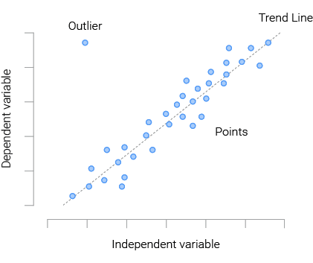
Modeling
Process of using our math to understand, describe and “play with” real-world situations and problems
By “play with” I mean:
be able to predict what will happen in this situation if things change a bit
answer questions about the situation
Often we will start with data
Data based on measurements or observations of the situation/problem
Sometimes that data is exact
Most of the time it is NOT exact
The data are approximations … close and good enough for us to work with
BUT NOT PRECISE!
What does it matter if it is close but not precise?
If you plot the data it does not fit nice and neat on a line
The data is “scattered”
The aggregate whole will be in a “cloud” that is mostly in a line shape
What do we do?
Find the “average” of the points and guess at the line that best fits
… our ability to measure precisely is limited

Slide 8
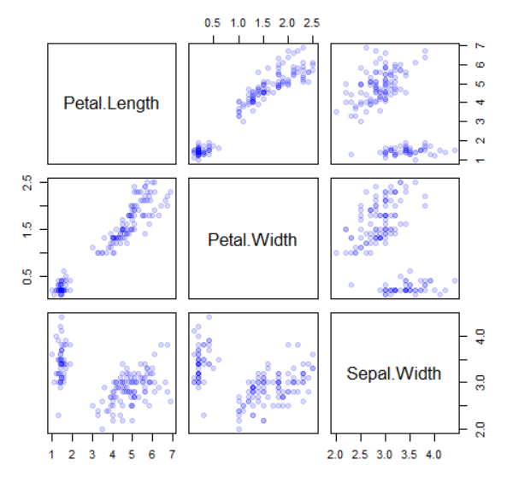
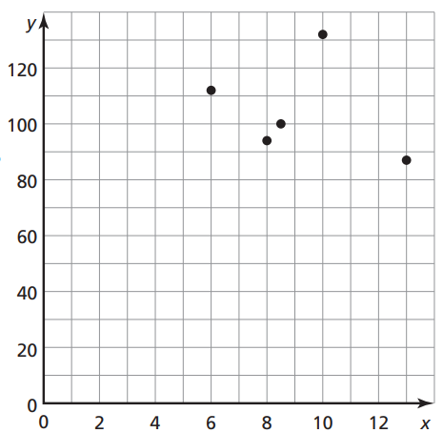
Does the data show a LINEAR RELATIONSHIP?
NO
YES
NO
YES
YES
NO
NO
NO

Slide 9
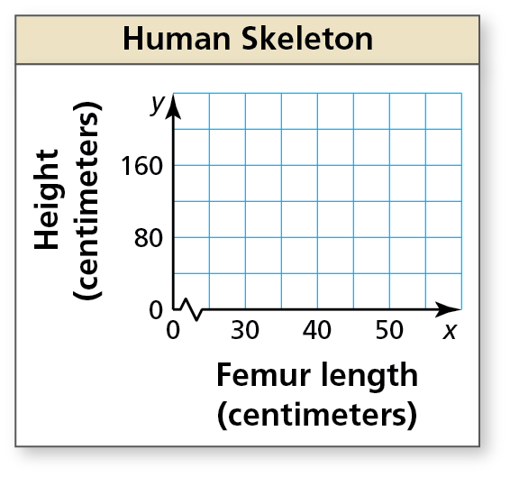
Femur length, x | Height, y
40 | 170
45 | 183
32 | 151
50 | 195
37 | 162
41 | 174
30 | 141
34 | 151
47 | 185
45 | 182
The table shows the femur lengths (in centimeters) and heights (in centimeters) of several people. Do the data show a linear relationship? If so, write an equation of a line of fit and use it to estimate the height of a person whose femur is 35 centimeters long.
SOLUTION
Step 1 Create a scatter plot of the data. The data show a linear relationship.
(40, 170)
Step 2 Sketch the line that most closely appears to fit the data.
Here is one possibility...
(50, 195)
Step 3 Choose two points on the line.
For the line shown, you might choose (40, 170) and (50, 195).
Step 4 Write an equation of the line.
First, find the slope.
m $=$ $\frac{\text{y}\text{2} − \text{y}\text{1}}{\text{x}\text{2 }− \text{x}\text{1}}$ $=$ $\frac{\text{195 }−\text{170}}{\text{50 }− \text{40}}$ $=$ $\frac{\text{25}}{\text{10}}$ $=$ 2.5

Slide 10
Step 4 Write an equation of the line.
First, find the slope.
m $=$ $\frac{\text{y}\text{2} − \text{y}\text{1}}{\text{x}\text{2 }− \text{x}\text{1}}$ $=$ $\frac{\text{195 }−\text{170}}{\text{50 }− \text{40}}$ $=$ $\frac{\text{25}}{\text{10}}$ $=$ 2.5
Use point-slope form to write an equation. Use (x₁, y₁) $=$ (40, 170).
y $−$ y₁ $=$ m(x $−$ x₁)
Point-slope form
y $−$ 170 $=$ 2.5(x $−$ 40)
Substitute for m, x₁, and y₁.
y $−$ 170 $=$ 2.5x $−$ 100
Distributive Property
Here we have found ***A*** Line of Fit
y $=$ 2.5x $+$ 70
Add 170 to each side.
Use the equation to estimate the height of the person.
y $=$ 2.5(35) $+$ 70
Substitute 35 for x.
$=$ 157.5
Simplify.
The approximate height of a person with a 35-centimeter femur is
157.5 centimeters.

Slide 11
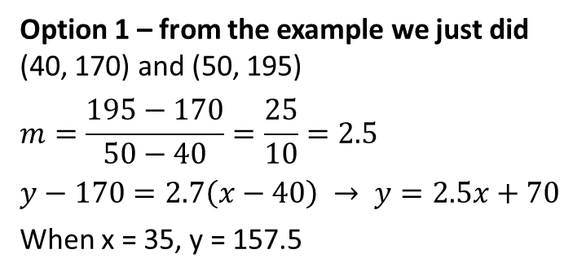


Femur length, x | Height, y
40 | 170
45 | 183
32 | 151
50 | 195
37 | 162
41 | 174
30 | 141
34 | 151
47 | 185
45 | 182
Option 1 – from the example we just did
(40, 170) and (50, 195)
$$m=\frac{195−170}{50−40}=\frac{25}{10}=2.5$$
$$y−170=2.7\left(x−40\right) → y=2.5x+70$$
When x = 35, y = 157.5
The points you chose are pretty important!
Option 2
(45, 183) and (47, 185)
$$m=\frac{185−183}{47−45}=\frac{2}{2}=1$$
$$y−183=1\left(x−45\right) → y=x+138$$
When x = 35, y = 173
– not a great choice
The points are too close to each other…
Option 3
(30, 141) and (50, 195)
$$m=\frac{195−141}{50−30}=\frac{54}{20}=2.7$$
$$y−141=2.7\left(x−30\right) → y=2.7x+60$$
When x = 35, y = 154.5
– much better choice than option 2
The points are:
At the “ends” of the data
and look to be really close the line we drew

Slide 12
So we just learned how to find a “LINE OF FIT”
The points you pick are SUUUPER important
Quite a bit of guess work here
You can easily come up with an equation (line of fit) that is pretty far off
I would LOVE to find the LINE OF BEST FIT!
There is a way
There is a process/algorithm that given a set of points (scatter plot) with find the line of BEST fit ☺
…but it is REALLY complicated
…the kind of stuff you will study in university toward the end of working on your math degree
Have no fear! Our calculators have been to university and have a great degree in mathematics!

Slide 13
Linear Regression
Name of the algorithm that can find the line of BEST fit
Gives you:
the equation of the line of BEST fit
Its confidence level in that line (how close the points lie to the provided line)
Confidence level
Tells us how well the equation correlates to (fits) the data provided
Called the CORRELATION COEFFICENT
Represented by the letter $r$
Closer $r$ is to 1 the better the equation correlates to the data
If $r$ is really close to +1 then the points lie really close to the line and it has a positive slope
If $r$ is really close to -1 then the points lie really close to the line and it has a negative slope
If $r$ is really close to 0 then the points do not lie close to any line (no linear relationship was found)

Slide 14
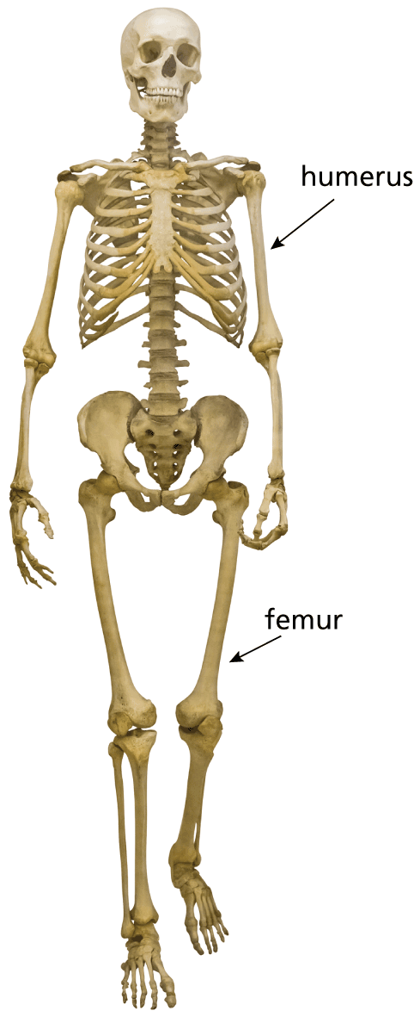
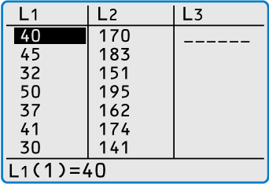
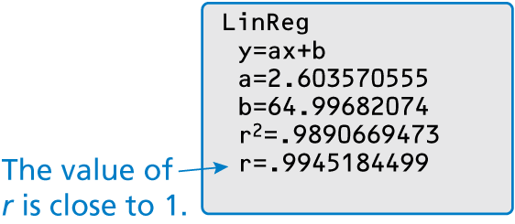
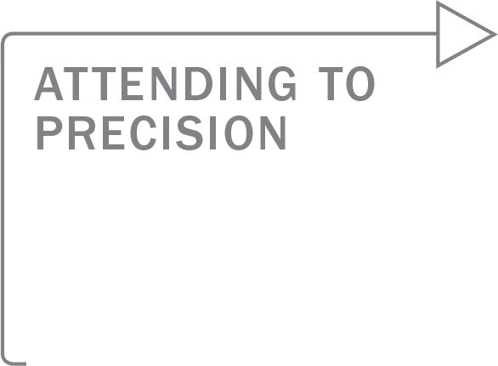
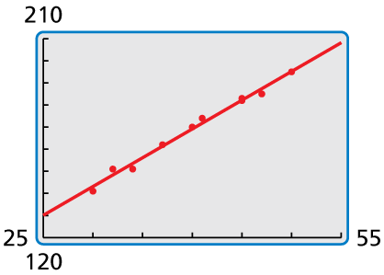
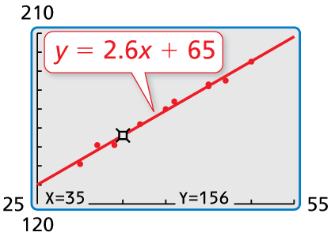
Use the linear regression feature on a graphing calculator to find an equation of the line of best fit for the data in Example 3. Estimate the height of a person whose femur is 35 centimeters long. Compare this height to your estimate in Example 3.
SOLUTION
Step 1 Enter the data into two lists.
Step 2 Use the linear regression feature. The line of best fit is y $=$ 2.6x $+$ 65.
Goggle “TI 84 how to enter data into list”
Goggle “TI 84 how to use linear regression”
Step 3 Graph the regression equation with the scatter plot.
Step 4 Use the trace feature to find the value of y when x $=$ 35.
Goggle “TI 84 how to graph regression equation”
Goggle “TI 84 how to use trace feature”
Be sure to analyze the
data values to help you
select an appropriate
viewing window for
your graph.
The approximate height of a person with a 35-centimeter femur is
156 centimeters. This is less than the estimate found in Example 3.

Slide 15
Review/Recap
Line of fit
“by hand” method to find an equation for a set of data that is “scattered”
Only works if the plotted data set is basically in the shape of a line (is linear)
Draw a line that runs through the points with half on each side
Pick two points close to the line, further apart from each other
Use those two points to come up with an equation
IS ONLY AN APPROXIMATION!
Line of BEST fit
Linear regression
Correlation coefficient $r$
Close to 1: good fit positive slope
Close to -1: good fit negative slope
Close to 0: no fit, not linear
Calculator method

Slide 16
Homework
Pg 27, #13-24, 27, 29, 32

